Slide 1
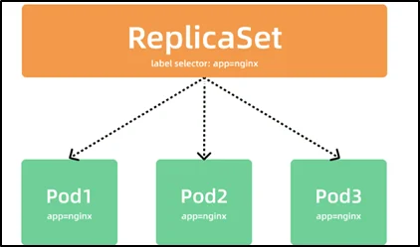
A
MINOR PROJECT
ON
K8S REPLICATIONSET
SUBMIT BY
RINKU SHARMA
SUBMIT TO
ASHISH MITTAL

Slide 2
Table of content
Introduction
What is a ReplicationSet
ReplicationSet Features
Scaling with ReplicationSets
Monitoring and Managing ReplicationSets
Hands on practice

Slide 3
Introduction
Kubernetes ReplicationSet is a powerful controller that ensures a specified number of replica Pods are running at all times.
It helps with scaling, fault tolerance, and load balancing in a Kubernetes cluster.
In this presentation, we will explore the features and benefits of Kubernetes ReplicationSet and understand how to effectively use it in your application deployments.

Slide 4
What is a ReplicationSet
A ReplicationSet is a Kubernetes controller that ensures a specified number of replicated Pods are running in a cluster.
It is the predecessor to the more advanced ReplicaSet, which offers additional features but has similar functionality.
ReplicationSets are often used for backward compatibility reasons or specific use cases.

Slide 5
ReplicationSet Features
Scaling: ReplicationSets can easily scale the number of Pods based on defined rules or manual intervention.
High Availability: By maintaining a specified number of replicas, ReplicationSets ensure fault tolerance and application availability.
Load Balancing: Pods created by a ReplicationSet can be distributed across multiple nodes, balancing the load on the cluster.
Rolling Updates: ReplicationSets support rolling updates, allowing you to update application versions with minimal downtime.

Slide 6
Scaling with ReplicationSets
Scaling a ReplicationSet can be done manually or automatically based on defined rules.
Manual scaling: Update the replicas field in the ReplicationSet manifest and apply the changes to the cluster.
Automatic scaling: Utilize the Horizontal Pod Autoscaler (HPA) to scale based on metrics like CPU utilization or custom metrics.

Slide 7
Monitoring and Managing ReplicationSets
Use kubectl commands to monitor and manage ReplicationSets.
View ReplicationSets: kubectl get replicasets
Scale ReplicationSets: kubectl scale replicasets my-replicaset --replicas=5
Delete ReplicationSets: kubectl delete replicasets my-replicaset
Monitor ReplicationSet events: kubectl describe replicasets my-replicaset

Slide 8
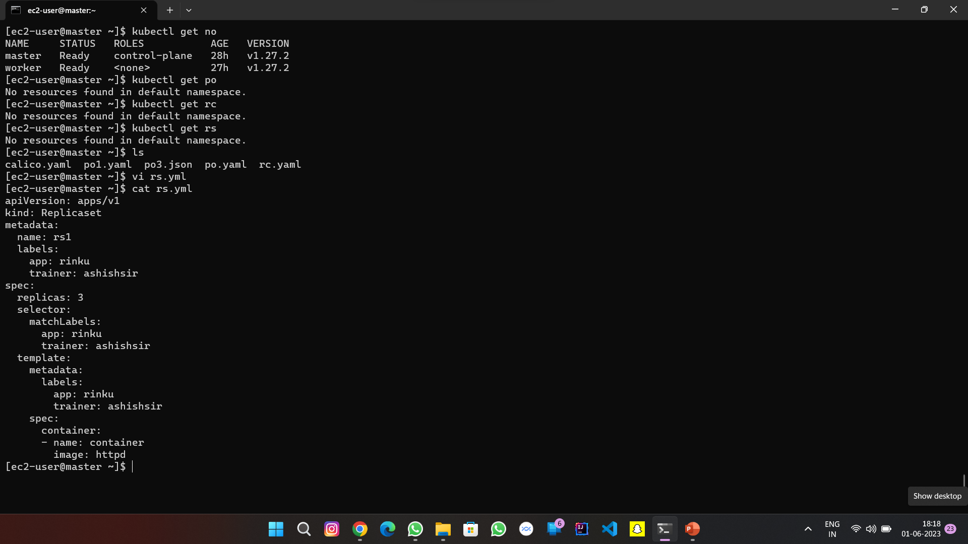
Hands on practice

Slide 9
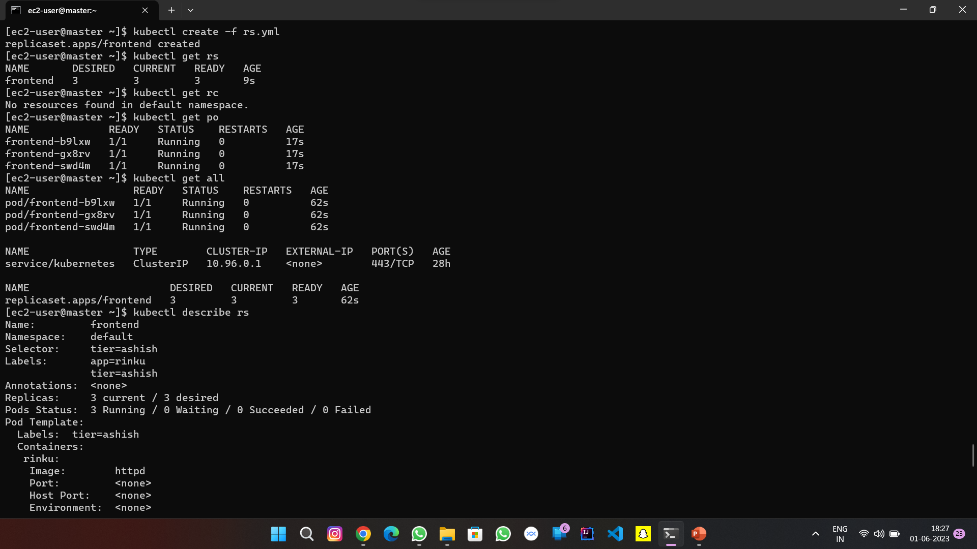

Slide 10
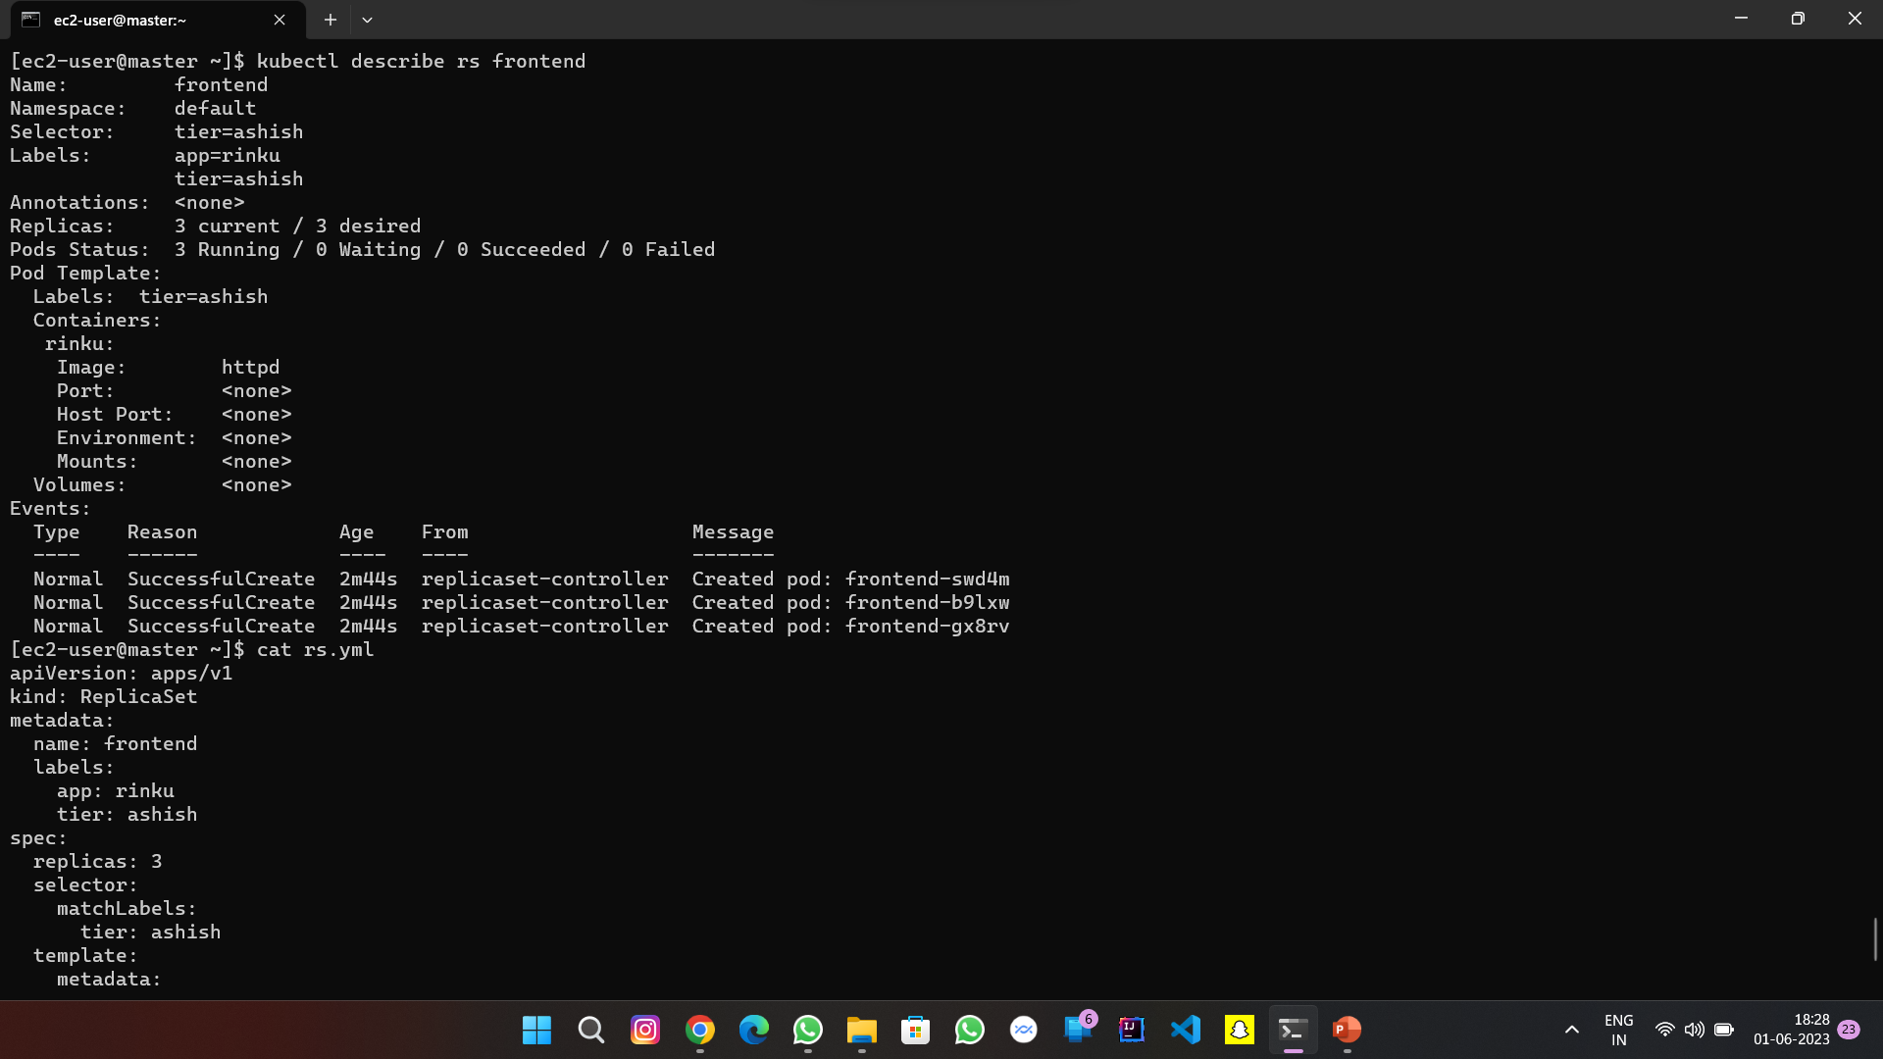

Slide 11
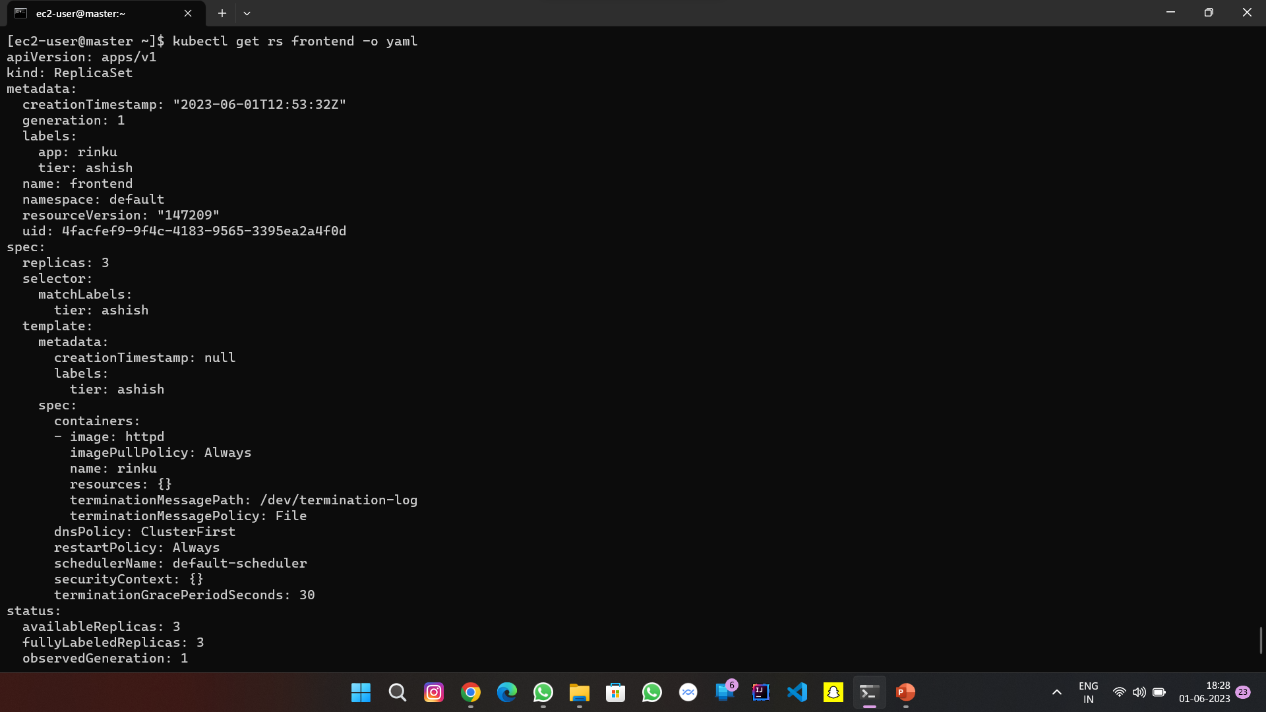

Slide 12
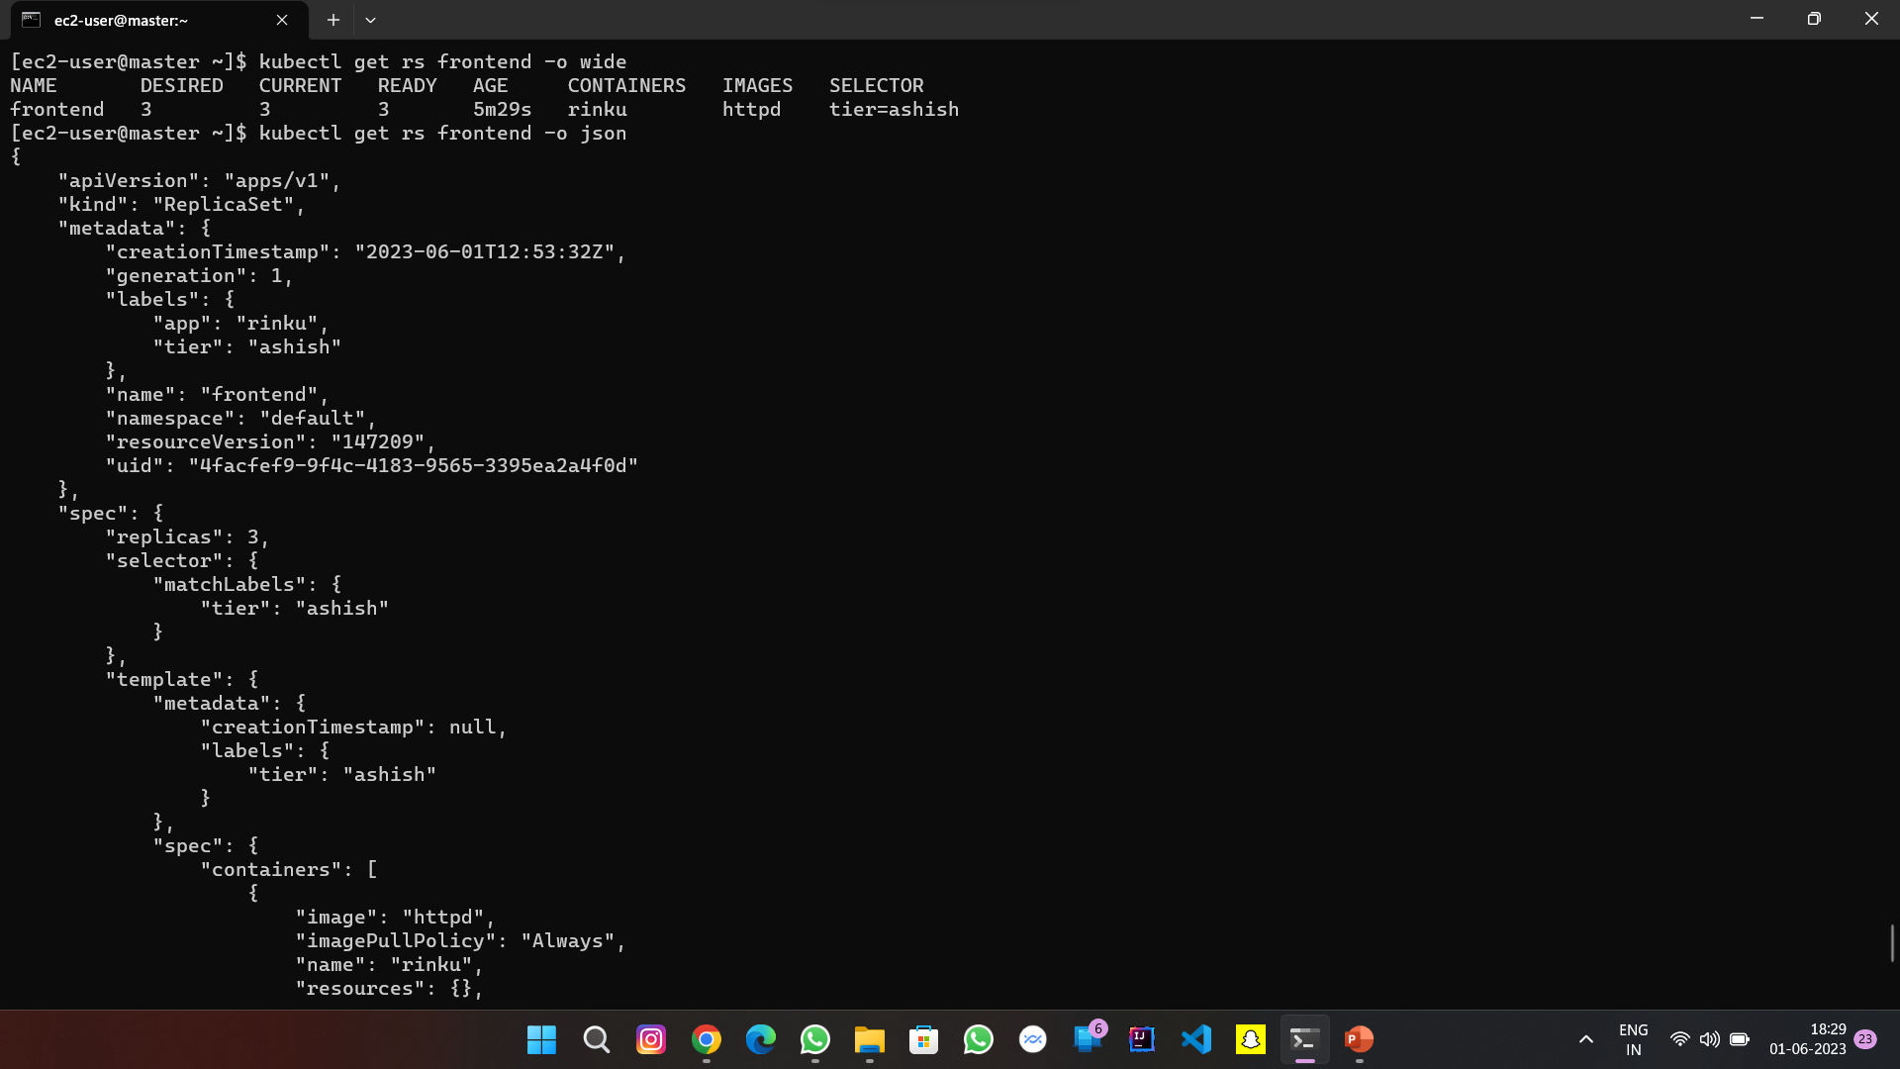

Slide 13
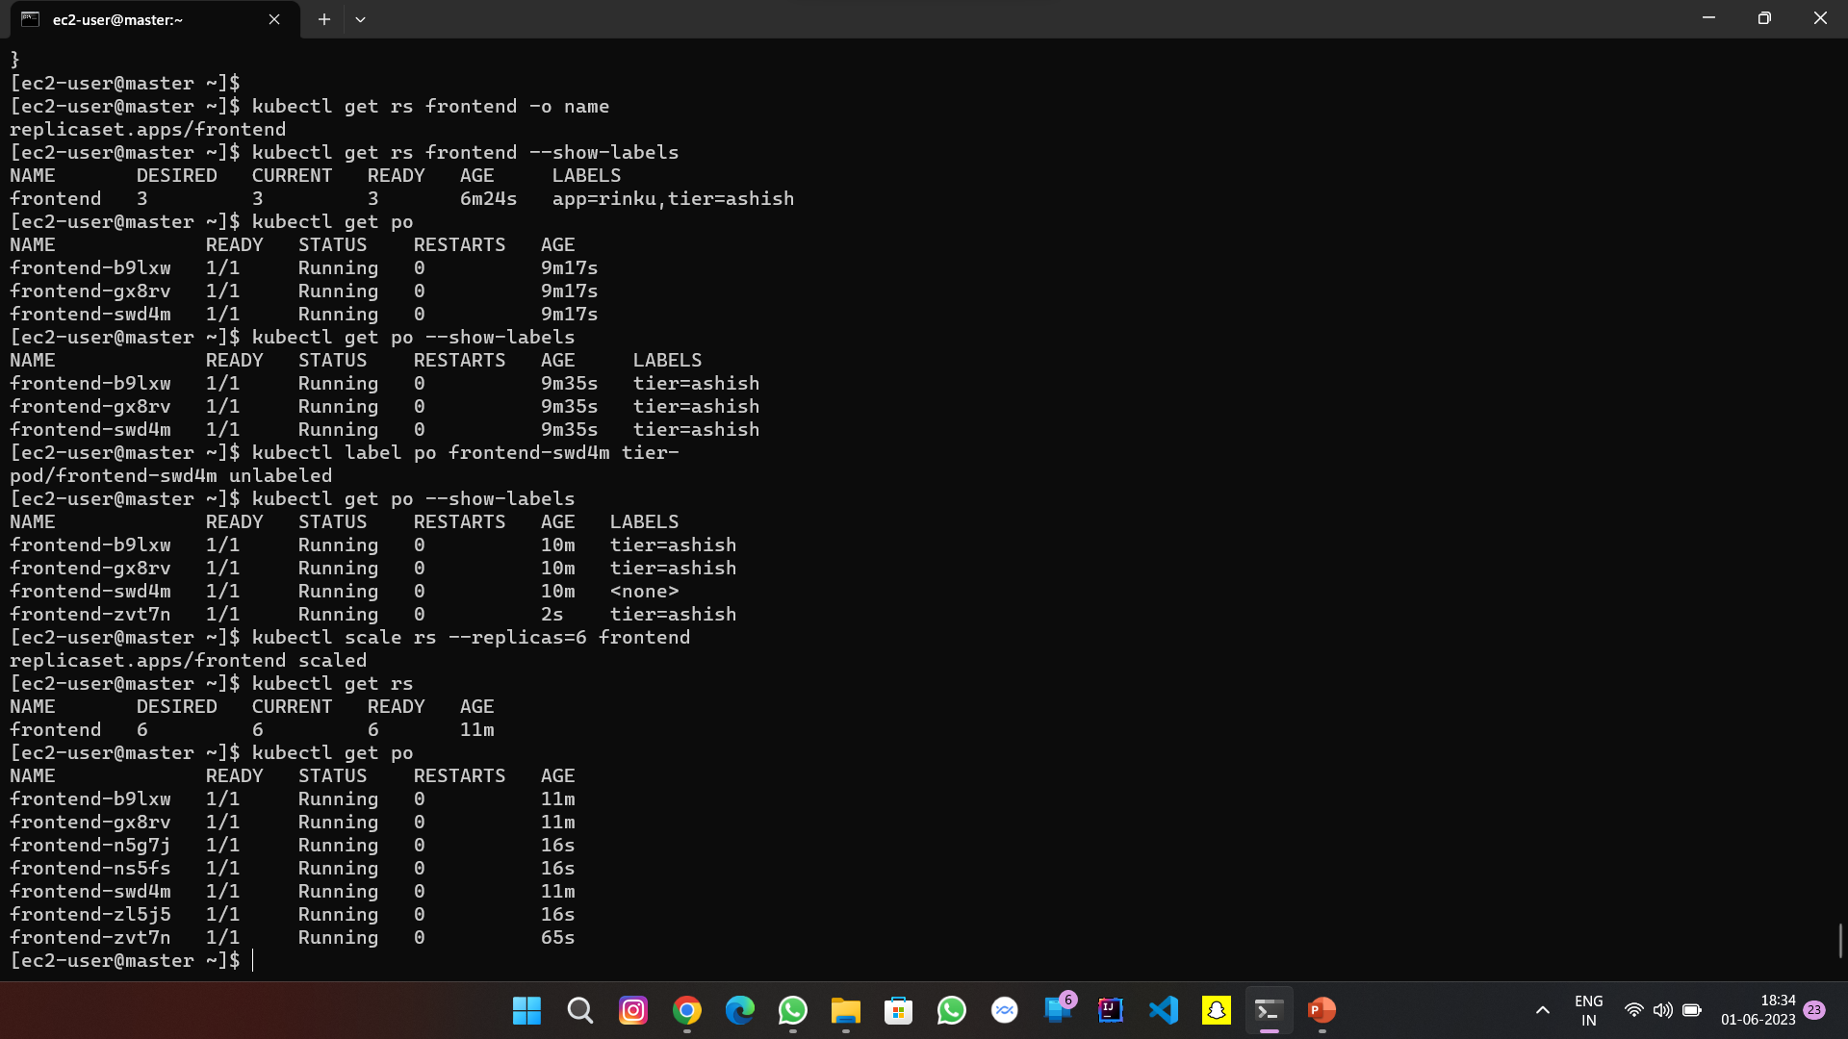

Slide 14
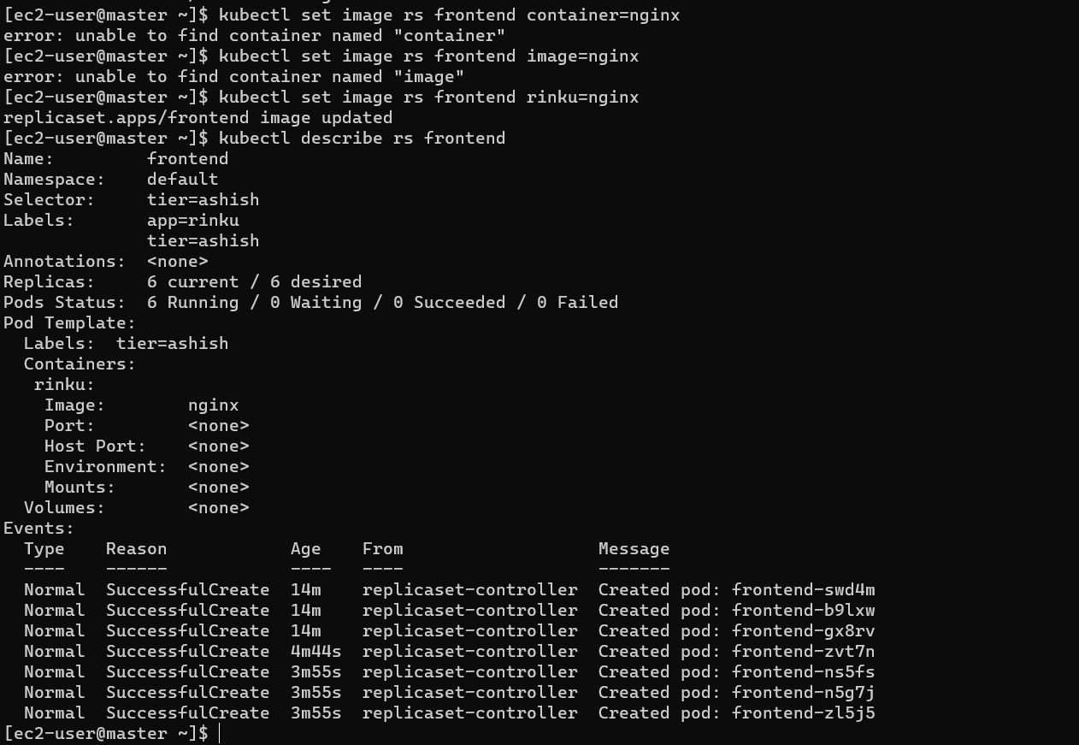

Slide 15
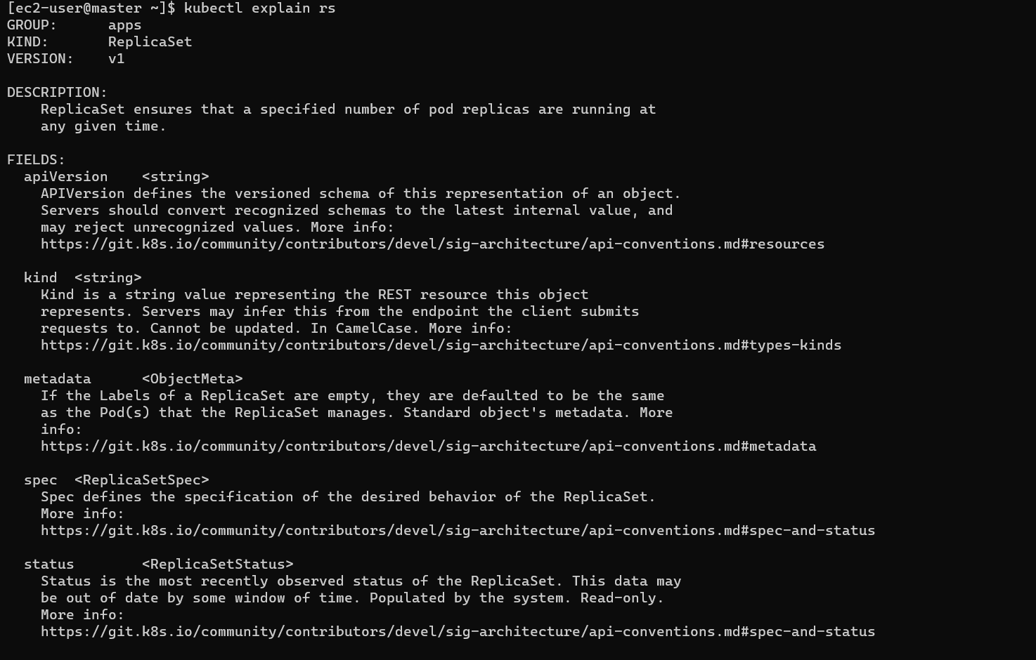

Slide 16
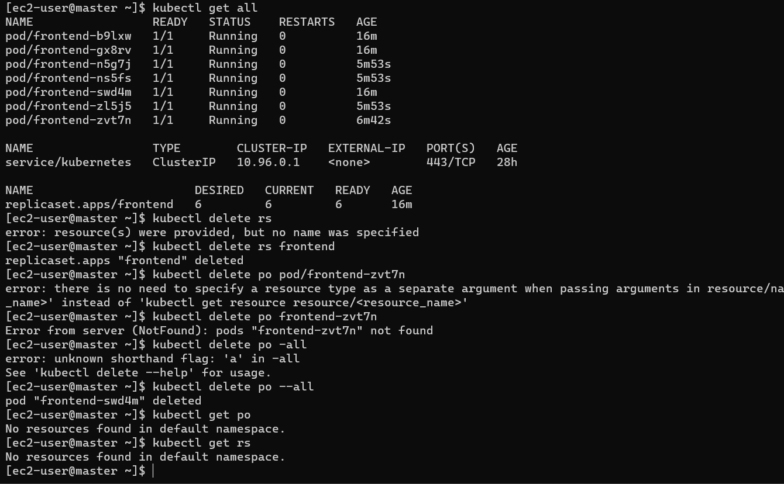

Slide 17


